Slide 1
Engineering Management
Planning Production Activity
PART 2
Lecture 34,35,36

Slide 2
INTRODUCTION
A breakeven analysis is used to determine how much sales volume your business needs to start making a profit.
The breakeven analysis is especially useful when you're developing a pricing strategy, either as part of a marketing plan or a business plan.
In economics & business, specifically cost accounting, the break-even point (BEP) is the point at which cost or expenses and revenue are equal: there is no net loss or gain,and one has "broken even".
Total cost = Total revenue = B.E.P.

Slide 3
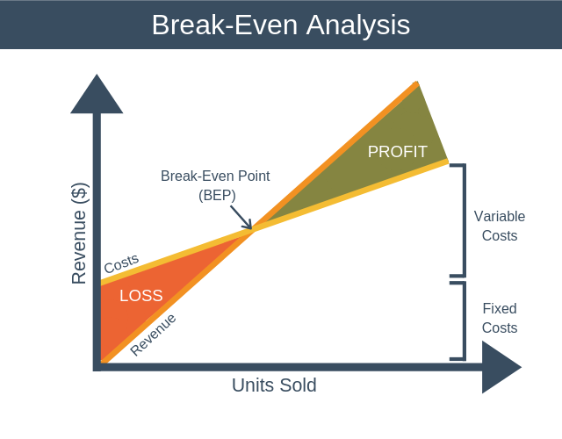

Slide 4
BREAK EVEN ANALYSIS
In order to calculate how profitable a product will be, we must
firstly look at the Costs Price and Revenue involved.
There are two basic types of costs a company incurs.
Variable Costs
Fixed Costs
Variable costs are costs that change with changes in production levels or sales. Examples include: Costs of materials used in the production of the goods.
Fixed costs remain roughly the same regardless of sales/output levels. Examples include: Rent, Insurance and Wages

Slide 5
Unit Price:
A unit price is the price for one item or measurement, such as a pound, a kilogram, or a pint, which can be used to compare the same type of goods sold in varying weights and amounts.
Total Cost:
The sum of the fixed cost and total variable cost for any given level of
production.
(Fixed Cost + Total Variable Cost )
Total Variable Cost:
The product of expected unit sales and variable unit cost.
(Expected Unit Sales * Variable Unit Cost )

Slide 6
Total Revenue:
The product of expected unit sales and unit price.
(Expected Unit Sales * Unit Price )
Profit/ loss
The monetary gain or loss resulting from revenues after subtracting all associated costs. (Total Revenue - Total Costs)

Slide 7
ASSUMPTIONS
Assumptions:
All elements of cost i.e. production, administration and selling distribution can be divided into fixed and variable components.
Variable costs remain constant per unit of output.
Fixed cost remain constant at all volume of output.
Selling price per unit remains unchanged or constant at all levels of output.
Volume of production is the only factor that influences cost.
There will be no change in the general price level.
There is one product and in case of multi product, the sales remain constant.

Slide 8
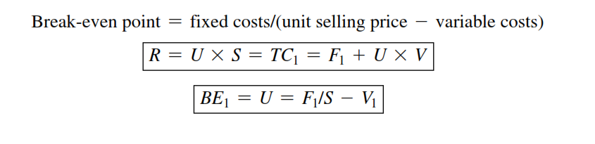
Calculation

Slide 9

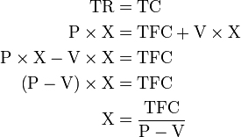
COMPUTATION
 The break-even point (in terms of Unit Sales (X)) can be directly computed in terms of Total Revenue (TR) and Total Costs (TC) as:
where:
TFC is Total Fixed Costs, P is Unit Sale Price, and V is Unit Variable Cost
The quantity (P – V) is of interest in its own right, and is called
the Unit Contribution Margin (C): it is the marginal profit per unit, or alternatively the portion of each sale that contributes to Fixed Costs

Slide 10
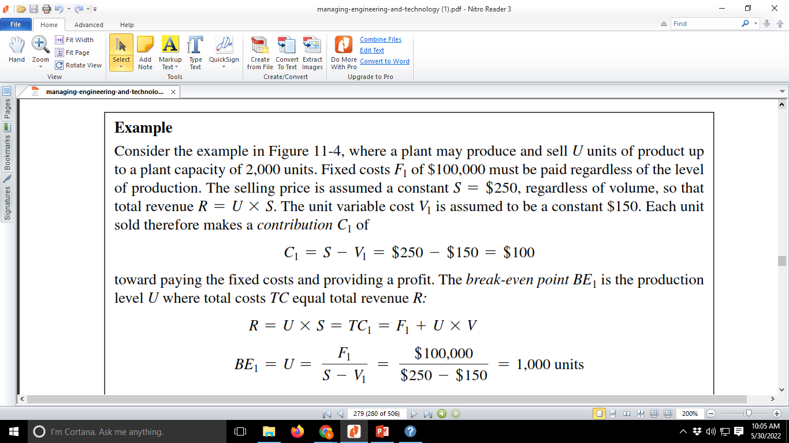
Problem

Slide 11
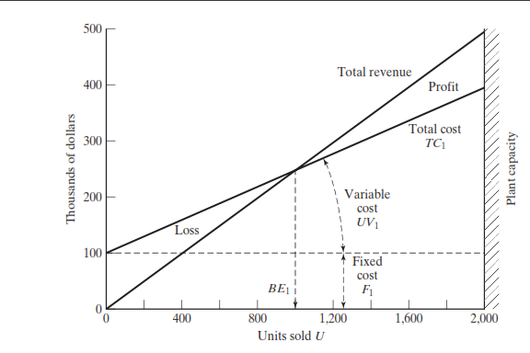
Problem

Slide 12
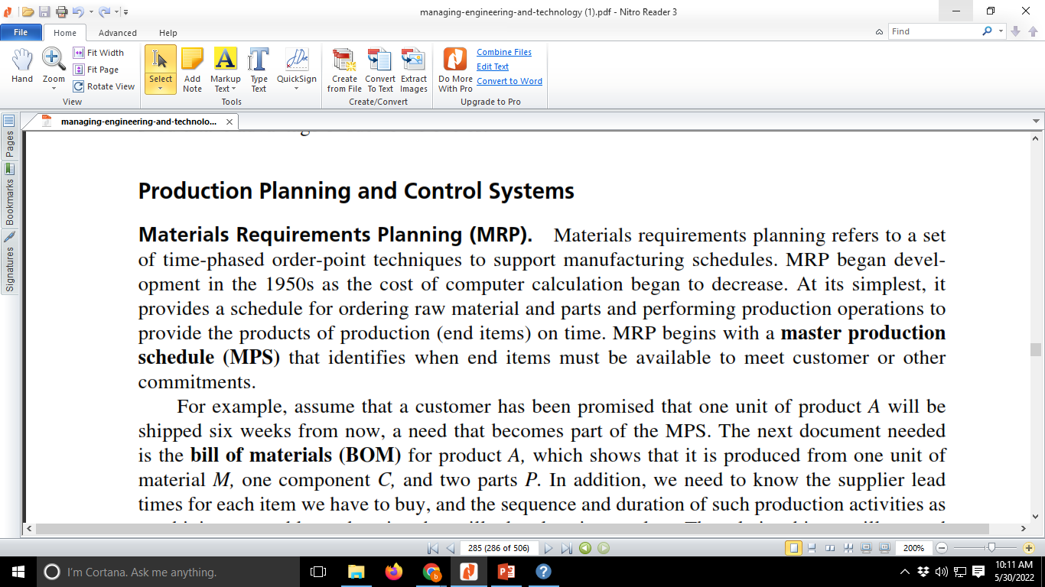
Production planning and control
Materials requirements Planning (MRP).

Slide 13
Production planning and control
Manufacturing resource Planning (MRP ii).
Customer demand activity
Production plans
Production schedules and their execution
Purchasing management
Inventory management
Product cost reporting
Supportofandfinancialapplicationsofaccountsreceivable,accountspayable,generalledger, and payroll

Slide 14
Lean Manufacturing
The principles and practices of Lean Manufacturing are simple and have evolved over the past century, beginning with Taylor and Gilbreth.
The key Lean Manufacturing principles are as follows:
Perfect first-time quality. Quest for zero defects, revealing and solving problems at the source
Waste minimization. Eliminating all activities that do not add value and safety nets, and maxi-mizing use of scarce resources (capital, people, and land)
Continuous improvement. Reducing costs, improving quality, increasing productivity, and sharing information
Pull processing. Products are pulled from the customer end, not pushed from the production end.
Flexibility. Producing different mixes or greater diversity of products quickly, without sacrificing efficiency at lower volumes of production
Building and maintaining a long-term relationship with suppliers through collaborative risk sharing, cost-sharing, and information-sharing arrangements

Slide 15
Supply chain Management
Supply chain management (SCM) is a series of processes that go into improving the way a company
finds the raw components it needs to make a product or service and delivers it to customers.
The goals are to lessen the time to market, reduce the cost to distribute, and supply the right products at the right time.
The concept of supply chain management is based on two core ideas. The first is that practically every product that reaches an end user represents the cumulative effort of multiple organizations. These organizations are referred to collectively as the supply chain.
The second idea is that while supply chains have existed for a long time, most organizations have only paid attention to what was happening within their organization.

Slide 16
Supply chain Management
The following are five basic components of SCM:
Plan. Define a strategy for managing all the resources
Source. Choose suppliers to deliver the goods and services
Make. Manufacturing step
Deliver. Logistics of getting products to customers
Return. Network for receiving defective and excess products from customers

